Slide 1

Reconocimiento de Patrones
Domingo Mery
Departmento de Ciencia de la Computación
Escuela de Ingeniería
Universidad Católica de Chile
Bag of Words
[ Capítulo 6 ]

Slide 2

PAT06_BoW.pptx

Slide 3
PAT06_BoW.pptx

Slide 4
descriptor
PAT06_BoW.pptx

Slide 5
10 | 30 | 11 | 12 | 13 | 29 | 22 | 12 | 13 | 30
descriptor
PAT06_BoW.pptx

Slide 6
10 | 30 | 11 | 12 | 13 | 29 | 22 | 12 | 13 | 30
10 | 10 | 12 | 34 | 12 | 10 | 12 | 34 | 12 | 9
12 | 29 | 11 | 10 | 12 | 10 | 12 | 34 | 12 | 14
3 | 10 | 12 | 34 | 12 | 10 | 12 | 34 | 12 | 14
12 | 12 | 3 | 10 | 12 | 12 | 3 | 10 | 12
12 | 10 | 12 | 34 | 12 | 10 | 12 | 34 | 12 | 14
11 | 10 | 12 | 34 | 12 | 10 | 12 | 34 | 12 | 14
12 | 29 | 11 | 10 | 12 | 10 | 12 | 34 | 12 | 14
3 | 10 | 12 | 34 | 12 | 12 | 12 | 3 | 10 | 12
12 | 12 | 3 | 10 | 12 | 12 | 12 | 3 | 10 | 12
10 | 10 | 12 | 34 | 12 | 10 | 12 | 34 | 12 | 14
10 | 10 | 12 | 34 | 12 | 10 | 12 | 34 | 12 | 9
12 | 29 | 11 | 10 | 12 | 10 | 12 | 34 | 12 | 14
3 | 10 | 12 | 34 | 12 | 10 | 12 | 34 | 12 | 14
12 | 12 | 3 | 10 | 12 | 12 | 3 | 10 | 12 | 15
12 | 10 | 12 | 34 | 12 | 10 | 12 | 34 | 12 | 14
11 | 10 | 12 | 34 | 12 | 10 | 12 | 34 | 12 | 14
12 | 29 | 11 | 10 | 12 | 10 | 12 | 34 | 12 | 14
3 | 10 | 12 | 34 | 12 | 12 | 12 | 3 | 10 | 12
12 | 12 | 3 | 10 | 12 | 12 | 12 | 3 | 10 | 12
10 | 10 | 12 | 34 | 12 | 10 | 12 | 34 | 12 | 14
12 | 12 | 3 | 10 | 12 | 12 | 3 | 10 | 12 | 17
description
PAT06_BoW.pptx

Slide 7
N
10 | 30 | 11 | 12 | 13 | 29 | 22 | 12 | 13 | 30
10 | 10 | 12 | 34 | 12 | 10 | 12 | 34 | 12 | 9
12 | 29 | 11 | 10 | 12 | 10 | 12 | 34 | 12 | 14
3 | 10 | 12 | 34 | 12 | 10 | 12 | 34 | 12 | 14
12 | 12 | 3 | 10 | 12 | 12 | 3 | 10 | 12
12 | 10 | 12 | 34 | 12 | 10 | 12 | 34 | 12 | 14
11 | 10 | 12 | 34 | 12 | 10 | 12 | 34 | 12 | 14
12 | 29 | 11 | 10 | 12 | 10 | 12 | 34 | 12 | 14
3 | 10 | 12 | 34 | 12 | 12 | 12 | 3 | 10 | 12
12 | 12 | 3 | 10 | 12 | 12 | 12 | 3 | 10 | 12
10 | 10 | 12 | 34 | 12 | 10 | 12 | 34 | 12 | 14
10 | 10 | 12 | 34 | 12 | 10 | 12 | 34 | 12 | 9
12 | 29 | 11 | 10 | 12 | 10 | 12 | 34 | 12 | 14
3 | 10 | 12 | 34 | 12 | 10 | 12 | 34 | 12 | 14
12 | 12 | 3 | 10 | 12 | 12 | 3 | 10 | 12 | 15
12 | 10 | 12 | 34 | 12 | 10 | 12 | 34 | 12 | 14
11 | 10 | 12 | 34 | 12 | 10 | 12 | 34 | 12 | 14
12 | 29 | 11 | 10 | 12 | 10 | 12 | 34 | 12 | 14
3 | 10 | 12 | 34 | 12 | 12 | 12 | 3 | 10 | 12
12 | 12 | 3 | 10 | 12 | 12 | 12 | 3 | 10 | 12
10 | 10 | 12 | 34 | 12 | 10 | 12 | 34 | 12 | 14
12 | 12 | 3 | 10 | 12 | 12 | 3 | 10 | 12 | 17
description
.
.
.
.
.
.
.
.
.
.
.
.
.
.
.
.
.
.
.
.
.
.
.
.
PAT06_BoW.pptx

Slide 8
.
.
.
.
.
.
.
.
.
.
.
.
.
.
.
.
.
.
.
.
.
.
.
.

Slide 9

.
.
.
.
.
.
.
.
.
.
.
.
.
.
.
.
.
.
.
.
.
.
.
.
.
.
.
.
.
.
.
.
.
.
.
.
.
.
.
.
.
.
.
.
.
PAT06_BoW.pptx

Slide 10

.
.
.
.
.
.
.
.
.
.
.
.
.
.
.
.
.
.
.
.
.
.
.
.
.
.
.
.
.
.
.
.
.
.
.
.
.
.
.
.
.
.
.
.
.
.
.
.
.
.
.
.
.
.
.
.
.
.
.
.
.
.
.
.
.
.
PAT06_BoW.pptx

Slide 11
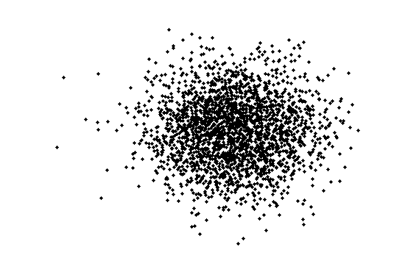
for all images
PAT06_BoW.pptx

Slide 12
Description of
all parts
PAT06_BoW.pptx

Slide 13
Description of
all parts
Description of
one part
PAT06_BoW.pptx

Slide 14
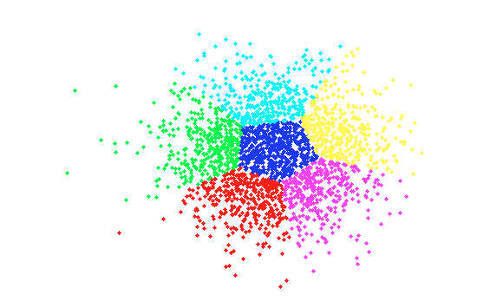
Visual Vocabulary
K-Means with K clusters
PAT06_BoW.pptx

Slide 15
Visual Vocabulary
K-Means with K clusters
PAT06_BoW.pptx

Slide 16
Visual Vocabulary
N
12 | 12 | 3 | 10 | 12 | 12 | 12 | 3 | 10 | 12
10 | 10 | 12 | 34 | 12 | 10 | 12 | 34 | 12 | 14
10 | 10 | 12 | 34 | 12 | 10 | 12 | 34 | 12 | 9
12 | 29 | 11 | 10 | 12 | 10 | 12 | 34 | 12 | 14
3 | 10 | 12 | 34 | 12 | 10 | 12 | 34 | 12 | 14
12 | 12 | 3 | 10 | 12 | 12 | 3 | 10 | 12 | 15
K
(coordinates of the centroids)
K-Means with K clusters
PAT06_BoW.pptx

Slide 17
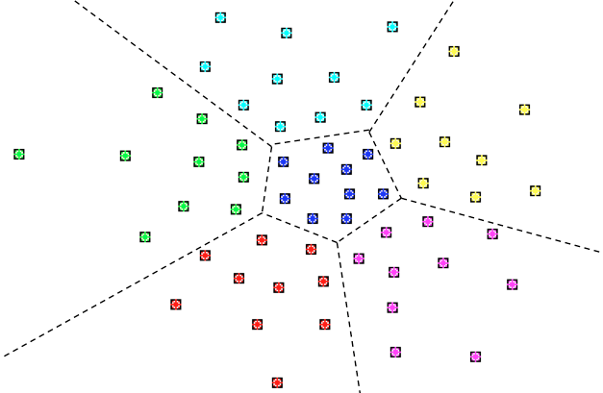

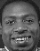
Example
John
K
PAT06_BoW.pptx

Slide 18






Example: More Dictionaries
Julio
Miguel
John
Ana
PAT06_BoW.pptx

Slide 19
Visual Vocabulary
N
12 | 12 | 3 | 10 | 12 | 12 | 12 | 3 | 10 | 12
10 | 10 | 12 | 34 | 12 | 10 | 12 | 34 | 12 | 14
10 | 10 | 12 | 34 | 12 | 10 | 12 | 34 | 12 | 9
12 | 29 | 11 | 10 | 12 | 10 | 12 | 34 | 12 | 14
3 | 10 | 12 | 34 | 12 | 10 | 12 | 34 | 12 | 14
12 | 12 | 3 | 10 | 12 | 12 | 3 | 10 | 12 | 15
1
2
3
4
5
6
K
2
3
1
4
5
6
Example with K=6 clusters
PAT06_BoW.pptx

Slide 20

descriptor
10 | 11 | 11 | 32 | 11 | 13 | 12 | 31 | 13 | 15
PAT06_BoW.pptx

Slide 21
10 | 11 | 11 | 32 | 11 | 13 | 12 | 31 | 13 | 15
PAT06_BoW.pptx

Slide 22
10 | 11 | 11 | 32 | 11 | 13 | 12 | 31 | 13 | 15
2
3
1
4
5
6
PAT06_BoW.pptx

Slide 23
10 | 11 | 11 | 32 | 11 | 13 | 12 | 31 | 13 | 15
2
3
1
4
5
6
PAT06_BoW.pptx

Slide 24
10 | 11 | 11 | 32 | 11 | 13 | 12 | 31 | 13 | 15
2
This part is represented by word 3
3
1
4
5
6
[ Encoding ]
PAT06_BoW.pptx

Slide 25
12 | 12 | 3 | 10 | 12 | 12 | 12 | 3 | 10 | 12
10 | 10 | 12 | 34 | 12 | 10 | 12 | 34 | 12 | 14
10 | 10 | 12 | 34 | 12 | 10 | 12 | 34 | 12 | 9
12 | 29 | 11 | 10 | 12 | 10 | 12 | 34 | 12 | 14
3 | 10 | 12 | 34 | 12 | 10 | 12 | 34 | 12 | 14
12 | 12 | 3 | 10 | 12 | 12 | 3 | 10 | 12 | 15
1
2
3
4
5
6
10 | 11 | 11 | 32 | 11 | 13 | 12 | 31 | 13 | 15
2
This part is represented by word 3
3
1
4
5
6
[ Encoding ]
PAT06_BoW.pptx

Slide 26
3
[ Encoding ]
PAT06_BoW.pptx

Slide 27
4
3
[ Encoding ]
PAT06_BoW.pptx

Slide 28
4
3
1
[ Encoding ]
PAT06_BoW.pptx

Slide 29
6
4
3
1
3
5
4
3
1
2
[ Encoding ]
PAT06_BoW.pptx

Slide 30
6
4
3
1
3
5
4
3
1
2
How many words ‘1’ are in this image?
PAT06_BoW.pptx

Slide 31
6
4
3
1
3
5
4
3
1
2
How many words ‘1’ are in this image?
Answer: 2
PAT06_BoW.pptx

Slide 32
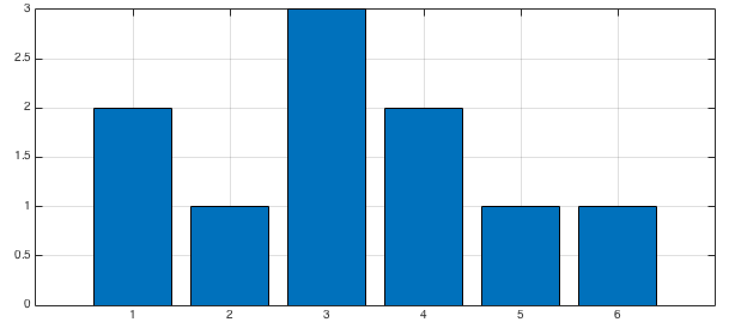
6
4
3
1
3
5
4
3
1
2
Histogram
PAT06_BoW.pptx

Slide 33
6
4
3
1
3
5
4
3
1
2
Histogram
PAT06_BoW.pptx

Slide 34

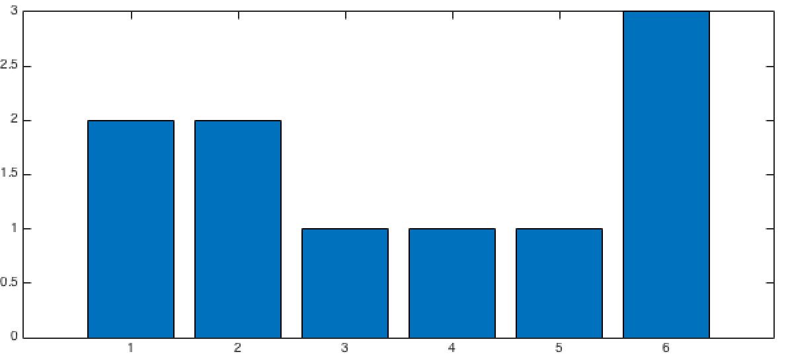
Histogram
different objects have different histograms
Histogram
PAT06_BoW.pptx

Slide 35

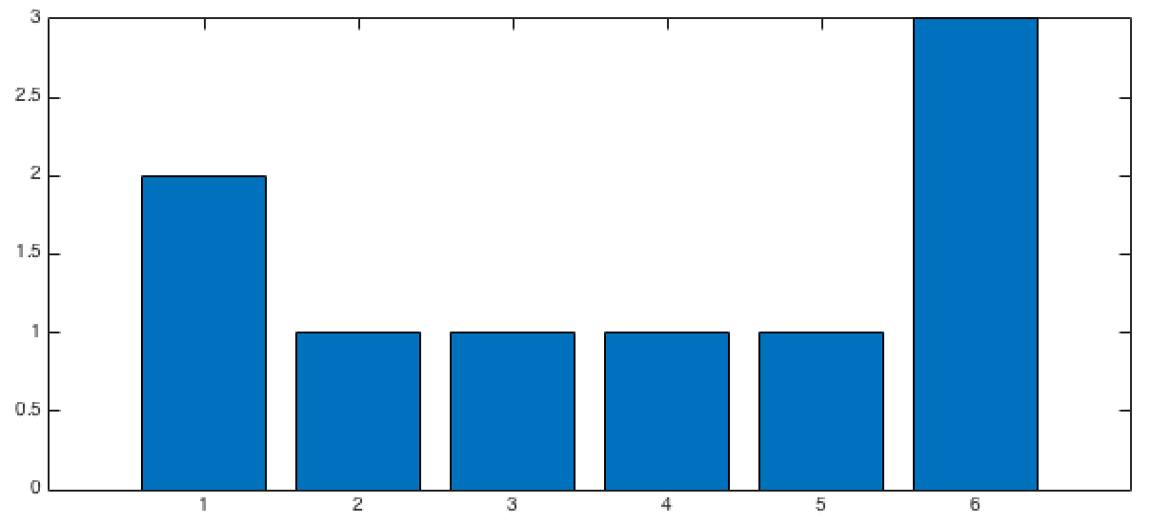
Histogram
Histogram
same objects have similar histograms
Histogram
PAT06_BoW.pptx

Slide 36
Summary
PART 1: VISUAL VOCABULARY
Collect representative images
Extract descriptors (example LBP, HOG, SIFT, etc.)
K-means (Visual Vocabulary of K words)
PAT06_BoW.pptx

Slide 37
Summary
PART 1: VISUAL VOCABULARY
Collect representative images
Extract descriptors
K-means (Visual Vocabulary of K words)
PART 2: CLASSIFIER DESIGN
1. For each image of the training set
- Extract descriptors and encode them using the Visual Vocabulary
- Build the histogram
Train a classifier using the new representation (histogram) of each image
Repeat for testing set and test the classifier
PAT06_BoW.pptx

Slide 38
Ejemplo Reconocimiento de Tigres (Biometría)

Slide 39
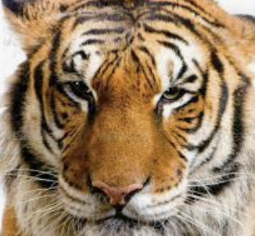
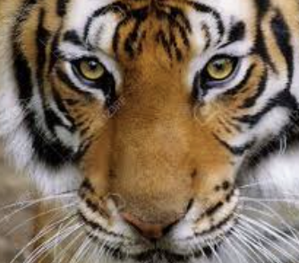
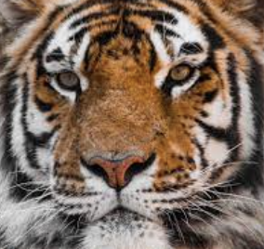
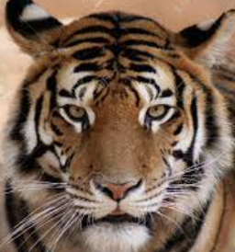
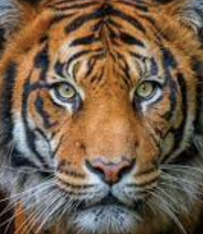
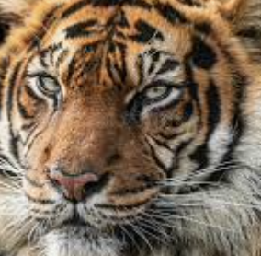
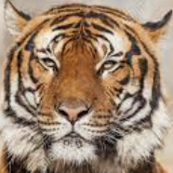
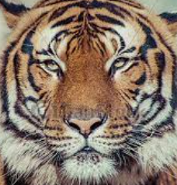
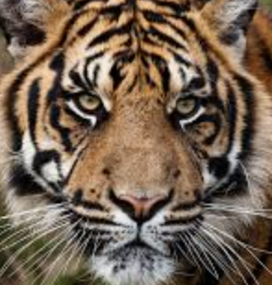
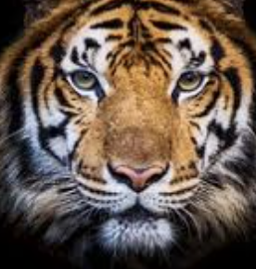
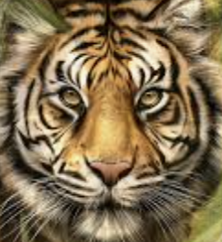
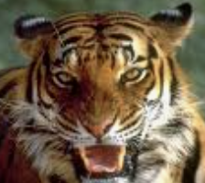
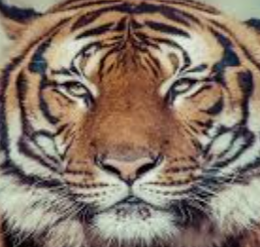
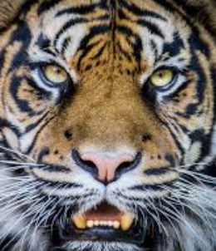
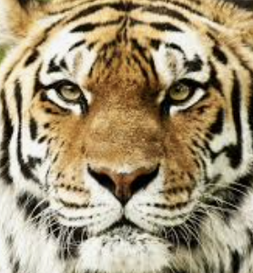
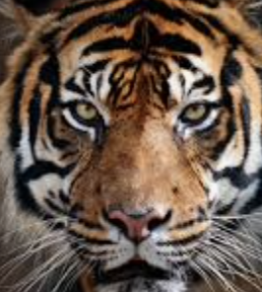
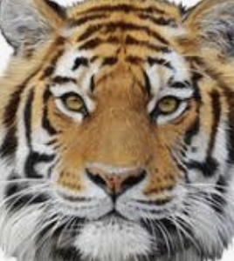
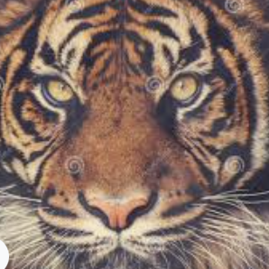

Slide 40
TRAINING

Slide 41
TRAINING
12 | 12 | 3 | 10 | 12 | 12 | 12 | 3 | 10 | 12
10 | 10 | 12 | 34 | 12 | 10 | 12 | 34 | 12 | 14
10 | 10 | 12 | 34 | 12 | 10 | 12 | 34 | 12 | 9
12 | 29 | 11 | 10 | 12 | 10 | 12 | 34 | 12 | 14
3 | 10 | 12 | 34 | 12 | 10 | 12 | 34 | 12 | 14
12 | 12 | 3 | 10 | 12 | 12 | 3 | 10 | 12 | 15
SIFT de cada una
de los Tigres
K-means de todos los SIFT

Slide 42
TRAINING
Coordenadas de K centroides
12 | 12 | 3 | 10 | 12 | 12 | 12 | 3 | 10 | 12
10 | 10 | 12 | 34 | 12 | 10 | 12 | 34 | 12 | 14
10 | 10 | 12 | 34 | 12 | 10 | 12 | 34 | 12 | 9
12 | 29 | 11 | 10 | 12 | 10 | 12 | 34 | 12 | 14
3 | 10 | 12 | 34 | 12 | 10 | 12 | 34 | 12 | 14
12 | 12 | 3 | 10 | 12 | 12 | 3 | 10 | 12 | 15
SIFT de cada una
de los Tigres
K-means de todos los SIFT
Diccionario de
K palabras
visuales
K
128

Slide 43
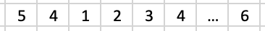
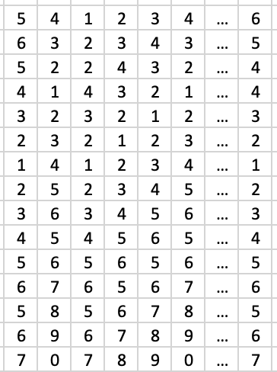
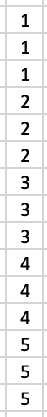
TRAINING
K
Para cada tigre del entrenamiento
SIFT
Codificación
Histograma
Entrenar
Clasificador
Clasificador
Entrenado
Histogramas Labels

Slide 44
TESTING

Slide 45
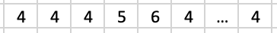
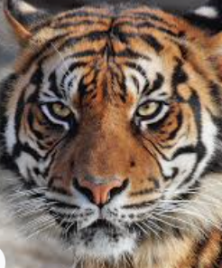
TESTING
K
Para el tigre de testing
SIFT
Codificación
Histograma

Slide 46
TESTING
Para el tigre de testing
SIFT
Codificación
Histograma
Clasificación
“3”

Slide 47
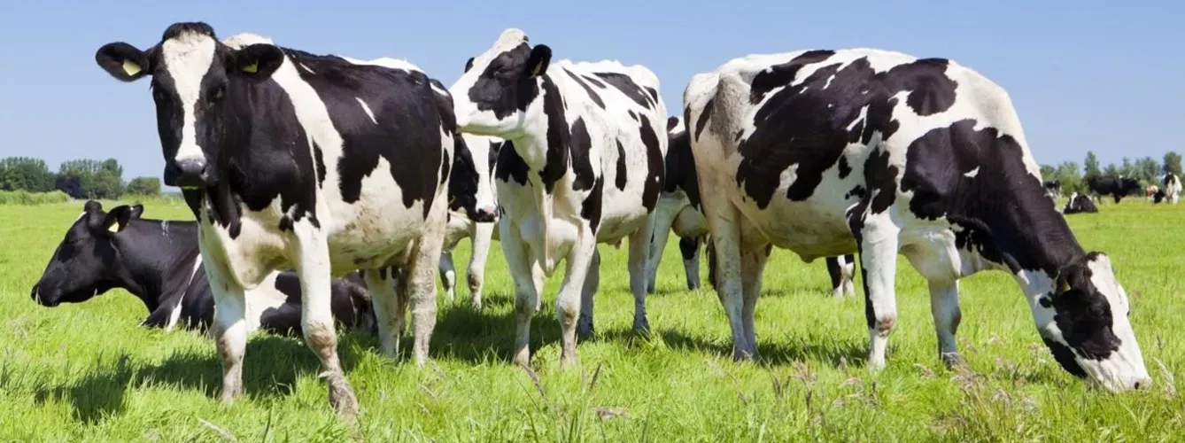
Se puede usar este método para reconocer vacas?

